Slide 1
The Effect of Covid in the Early Stages on Mississauga Businesses
Jennifer McNenly
Student ID# 500105361
April 7, 2023

Slide 2
Research Questions & Github information
Did the ones that failed before 2020 look like the ones that failed after 2020?
Which factors impacted the viability of businesses to survive during 2020, the first year of the pandemic (business size, NAICS code, location, etc…)?
Can we forecast which businesses failed in 2020 and why?
Were smaller businesses more adversely affected in certain industries?
Were businesses that had been in the Directory longer less likely to fail?
What does the latest year of the directory tell us about the current state of businesses in Mississauga?
Did industry share shrink in certain industries?
Github : https://github.com/mcnenlyj/MississaugaBusinesses

Slide 3
Techniques, Tools and Libraries
Data cleaning: Forwards fill / Backwards fill for missing data grouped by BusinessID. Created new fields for ‘Closed’ and ‘isnew’. Converted unique fields to binary (‘WebAddress’, ‘Email’, ‘Fax’, ‘TollFree’, Phone) and made size ‘EmplRange’ an ordinal
SKLEARN, Pandas, Numpy, Matplotlib, Seaborn, IMLEARN, Pandas-Profiling, PowerBI
KMeans for NAICS clustering
Feature selection using RFECV and filter based predictors
RFECV found 4 features – Ward, EmplRange, X, Y but only X and Y were found to be significant and over the 0.4 threshold. This is consistent with what the Naïve Bayes classifier found.
Filter based predictors found no features over the 0.4 threshold!
Notes:
Imbalanced learn for the SMOTE techniques
sklearn.model_selection and feature.selection for RFECV and filter based predictors
Created the closed and open fields by asking did the company (by business ID) exist in either the next year or the previous. If not in the previous then it is new. If it did not exist in the following year then closed. All of 2016 is new versus all of 2021 is not closed. Could not tell if 2021 business had closed until I looked at the 2022 data.
RFECV (Recursive Feature Elimination with Cross-Validation) performs recursive feature elimination with cross-validation loop to extract the optimal features. Scikit-learn provides RFECV class to implement RFECV method to find the most important features in a given dataset
Cross-validation is a technique for evaluating ML models by training several ML models on subsets of the available input data and evaluating them on the complementary subset of the data

Slide 4
Techniques - Predictive modeling / Classification
Used Decision Tree, Naïve Bayes GaussianNB and MultinomialNB. Various SMOTE techniques were used to address unbalanced training data set. 80 train/20 test split.
Decision Tree model had the best results when set to 5 levels. Attributes predicting ‘Closed’ were ‘NAICSDescr’, ‘Email’ and ‘StreetName’
Naïve Bayes GaussianNB - Except for recall TNR and G-Mean, all the other metrics are worse than the decision tree model. Accuracy remained unchanged between the two. Attributes predicting ‘Closed’ were ‘X’ (Latitude), ‘Y’(‘Longitude’) and Age
Naïve Bayes MultinomialNB did not improve on the GaussianNB results after addressing and replacing the negative values of ‘X’ with positive values
Classifier results with SMOTENC improved on the existing scores using one continuous and one categorical feature, ‘EmplRange’ and ‘NAICSCode’ with the target ‘Closed’. Performed better as it had a balanced data set.
Notes:
Really became a binomial logistic regression problem rather than linear as the data was all within one year 2019. Decision Tree and Naïve Bayes both improved in terms of time to run the analysis the more I cleaned up the data eg. Made binary fields out of unique values

Slide 5
Comparing Confusion Matrix results
 | actual
predicted | No- | Yes+
No- | 2752 (DT); 2768 (GNB); 2768 (MNB); 1470 (SMOTENC) | 10 (DT); 0 (GNB) ; 0 (MNB); 1291 (SMOTENC)
Yes+ | 537 (DT); 536 (GNB); 536 (MNB); 220 (SMOTENC) | 5 (DT); 0 (GNB) ; 0 (MNB); 323 (SMOTENC)

Slide 6
Comparing Model results
Model | Decision Tree | Naïve Bayes GaussianNB | Naïve Bayes MultinomialNB | SMOTENC
Accuracy | 0.83 | 0.81 | 0.56 | 0.54
Precision P+ | 0.33 | 0.24 | 0.18 | 0.20
Precision P- | 0.84 | 0.84 | 0.84 | 0.87
Recall TPR | 0.01 | 0.08 | 0.45 | 0.59
Recall TNR | 1.00 | 0.95 | 0.59 | 0.53
F+ | 0.02 | 0.12 | 0.25 | 0.30
F- | 0.91 | 0.89 | 0.69 | 0.66
G-Mean | 0.1 | 0.28 | 0.52 | 0.56
Notes:
Accuracy (TN + TP/TN+FP+TP+FN) is not a good measure if the dataset is unbalanced. Precision (TP/TP+FP) ideally should be 1 when TP =1 and FP=0. Recal (TP/TP+TN) should ideally be 1 when TP=1 and TN=0. F1 = 2*Precision*Recall/Precision+Recall. F1 becomes one if precision and recall are 1.
Models were better at predicting businesses that survived rather than failed, even after SMOTE overfitting techniques were applied. SMOTENC had the best overall results as it used a balanced data set. Decision Tree was faster and performed better than Naïve Bayes.

Slide 7
Conclusions
Industries that fared the worst between 2019 and 2021 were Wholesale Trade, Manufacturing and Professional, Scientific and Technical Services. Retail Trade was third if we looked a sheer number of business closures rather than percentage drop. Industries which survived best were Primary Industry, Utilities and Health Care and Social Assistance.
Businesses sizes that fared the worst were 1-4, 10-19 and 5-9. Though if we look at sheer number of closures then 10-19 comes in third place instead. Businesses that survived best were 1000+ employees, 300-499 and 500-999.
Age of business was related to survival. From worst to best, in order, were 4 years old (-1681), 2 years old (-378), 1 years old (-347) and 3 years old (-308). Older businesses that were listed in the Directory the longest were most likely to close.
Models were better at predicting businesses that survived rather than failed, even after SMOTE overfitting techniques were applied. SMOTENC had the best overall results as it used a balanced data set. Decision Tree was faster and performed better than Naïve Bayes.

Slide 8
Limitations and future suggestion for improvement
There was not enough attributes to accurately predict and describe why businesses closed.
To improve results in future, I would look to add more demographic data like average household income of people living in each area, unemployment rate, proximity to shopping areas and others to improve the prediction models

Slide 9
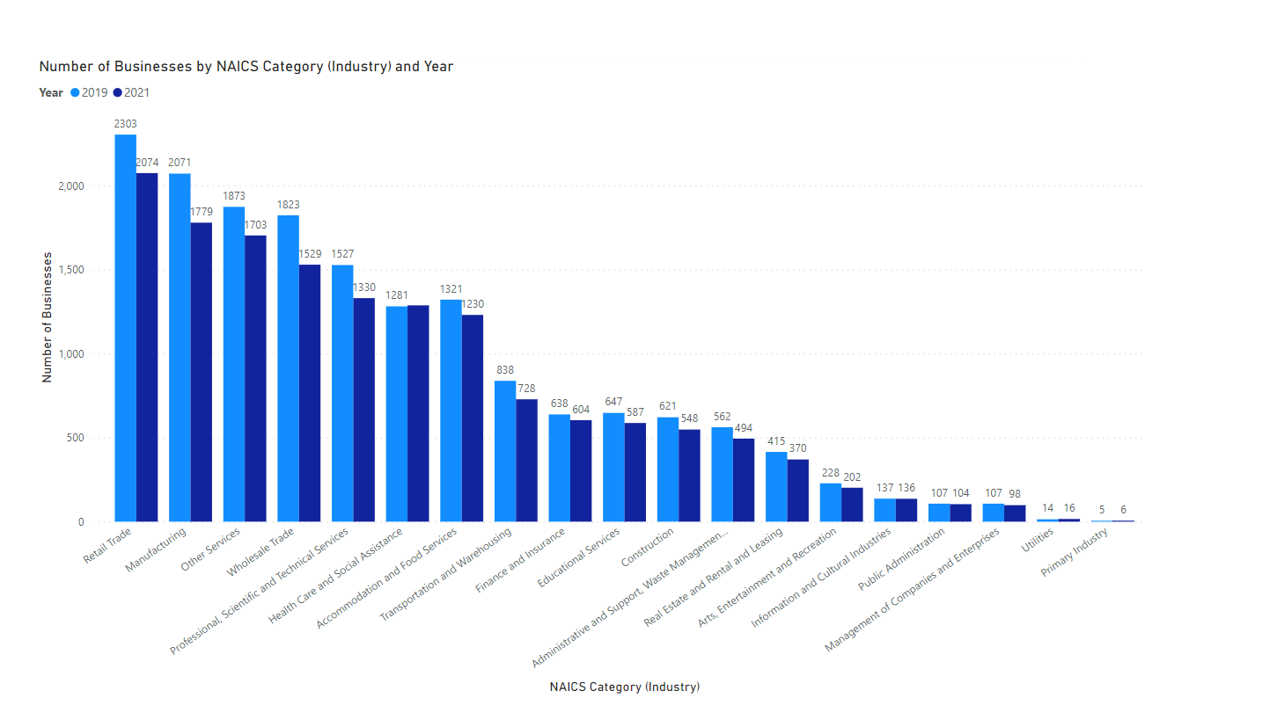
Notes:
Industries before the pandemic were similar and experienced year over year increases
Industries that fared the worst between 2019 and 2021 were Wholesale Trade, Manufacturing and Professional, Scientific and Technical Services. Retail Trade was third if we looked a sheer number of business closures rather than percentage drop. Industries which survived best were Primary Industry, Utilities and Health Care and Social Assistance.

Slide 10
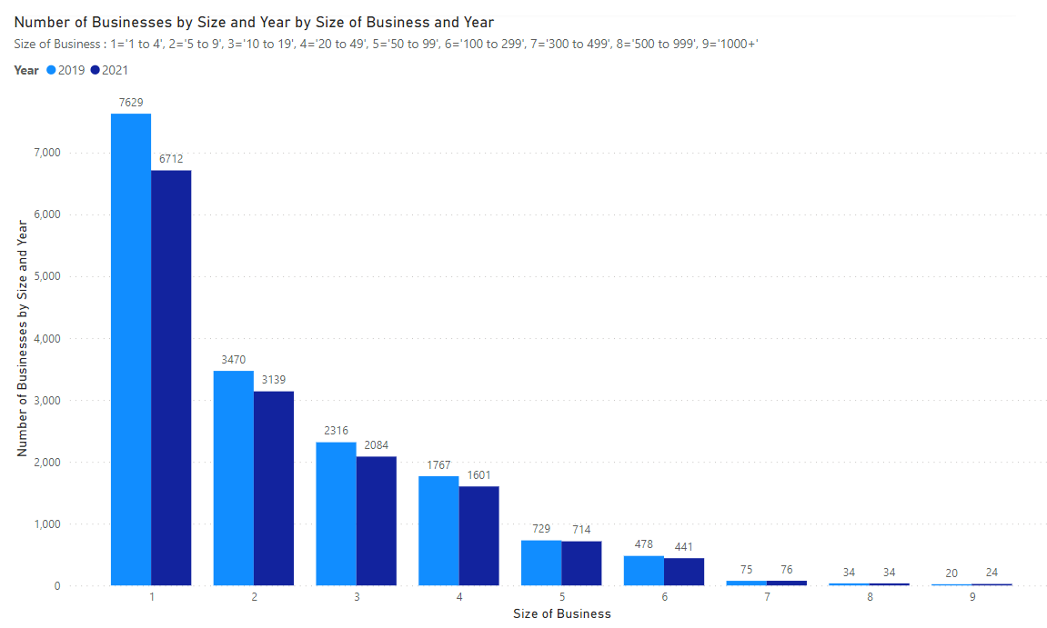
Notes:
Businesses sizes that fared the worst were 1-4, 10-19 and 5-9. Though if we look at sheer number of closures then 10-19 comes in third place instead. Businesses that survived best were 1000+ employees, 300-499 and 500-999.

Slide 11
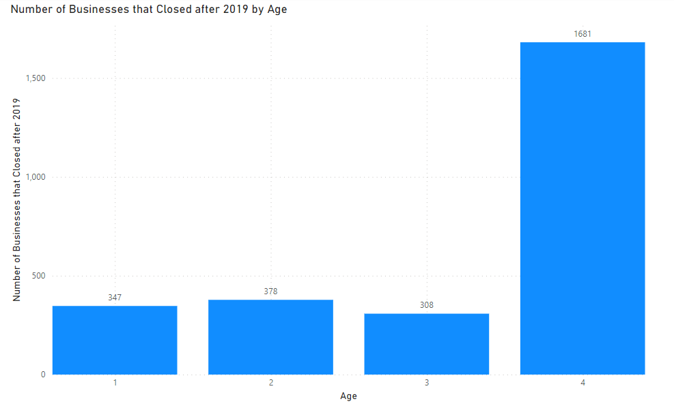
Business Closures by Age (number of years listed in the Directory)
Businesses that were the oldest were the hardest hit with closures after 2019
Notes:
Age of business was related to survival. From worst to best, in order, were 4 years old (-1681), 2 years old (-378), 1 years old (-347) and 3 years old (-308). Older businesses that were listed in the Directory the longest were most likely to close.

Slide 12
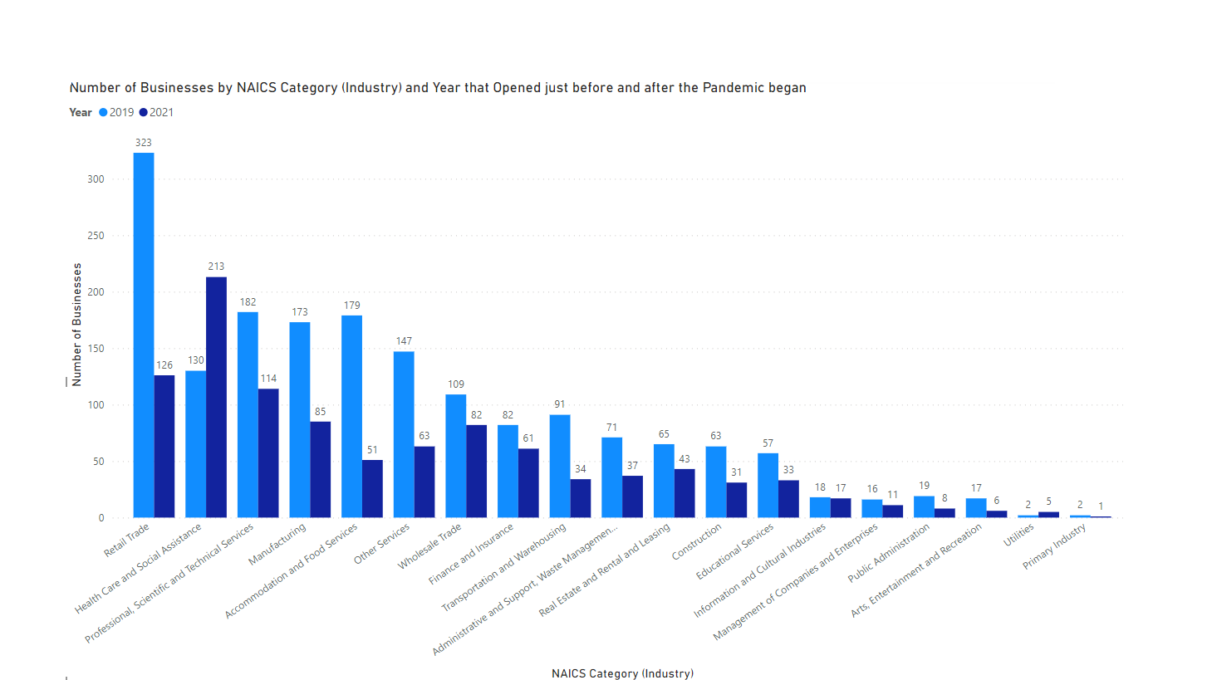
Notes:
Health Care and Social Assistance was popular after 2019. Retail Trade was popular before.

Slide 13
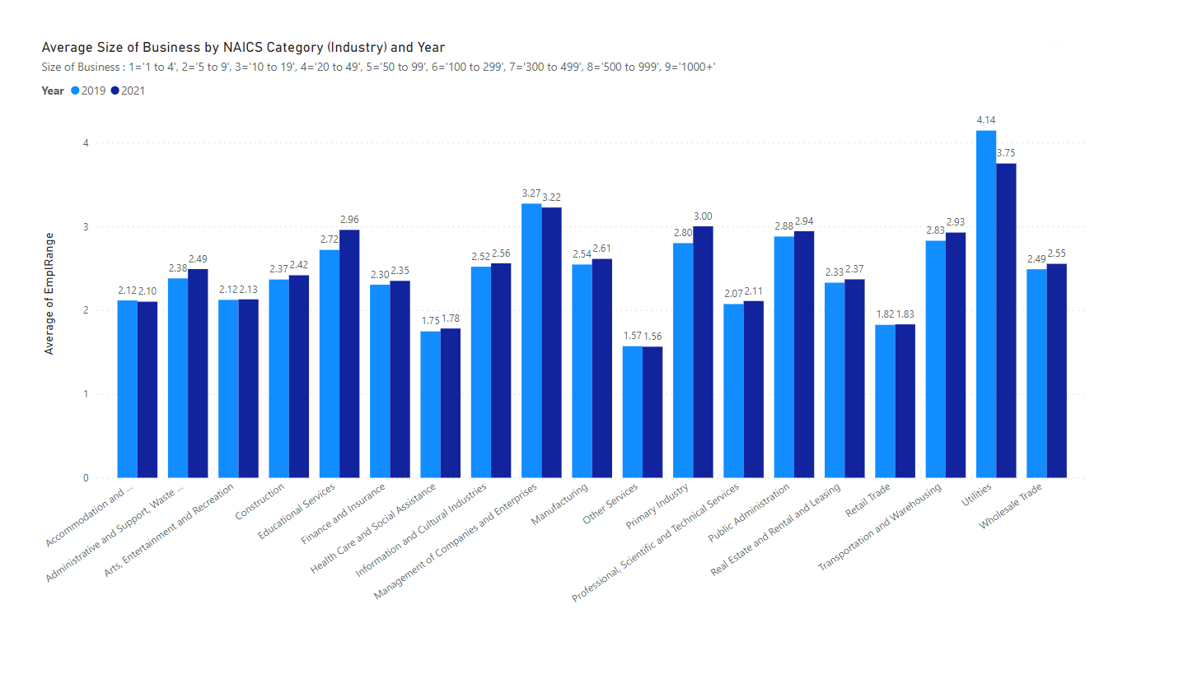

Slide 14
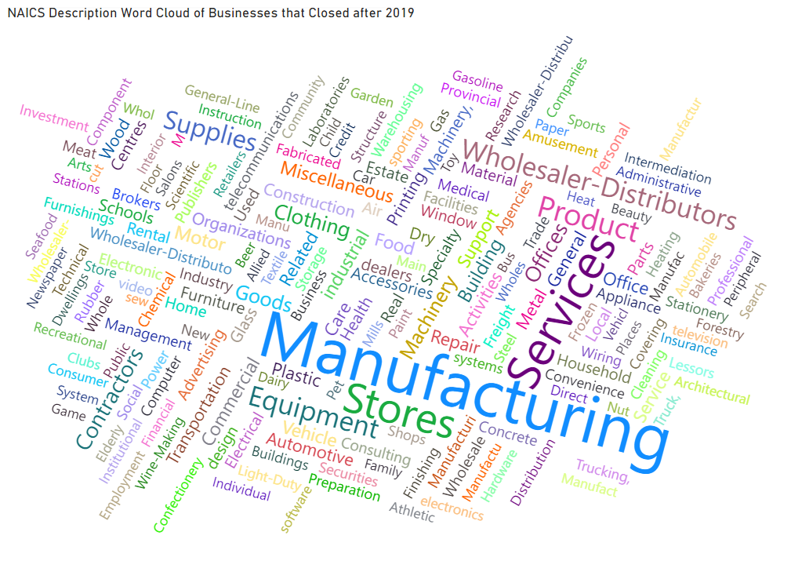

Slide 15
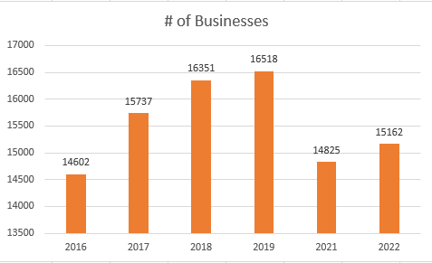
BONUS! 2022 Data was released March 30, 2023
All sizes of businesses rebounded except 1-4 and 500-999 employees
All industries rebounded except
Wholesale Trade
Transportation and Warehousing
Real Estate and Rental and Leasing
Information and Cultural Industries
Finance and Insurance

Slide 16
Thank you for an amazing certificate experience!

